Slide 1
Status Report #15
This week
2020. Feb 20 (Thu)
B4 FUJIWARA Tomomasa
ToF: Beam time data analysis
ToF: Cosmic
New circuit design

Slide 2
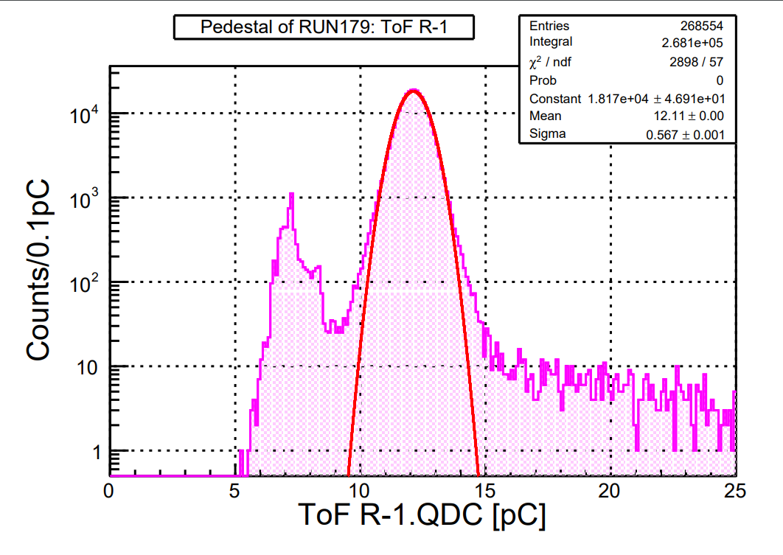
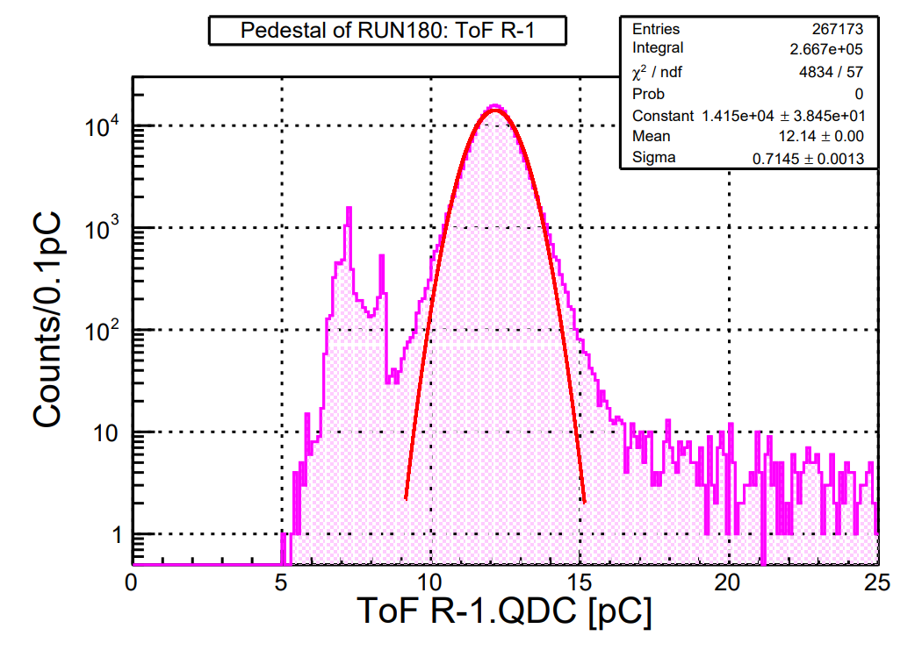
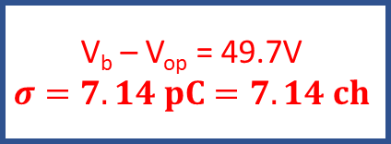
Beam time data analysis
Checked pedestal distribution in high voltage region
V_{b} – V_{op} = 49.7V
$$σ=7.14 pC=7.14 ch$$

Slide 3
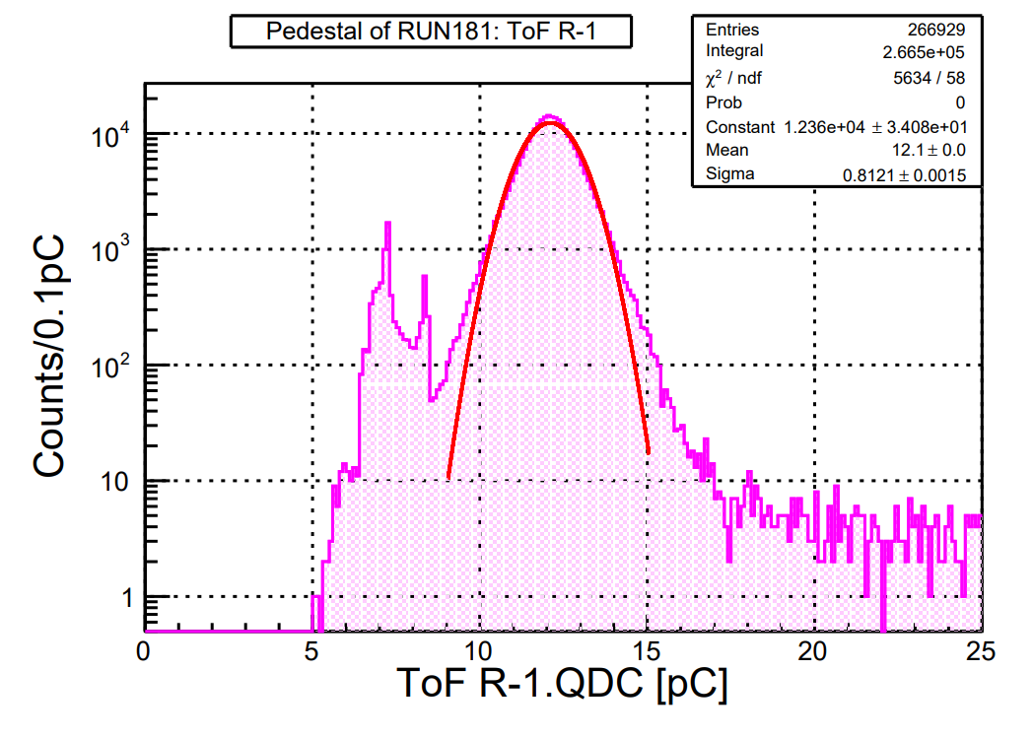
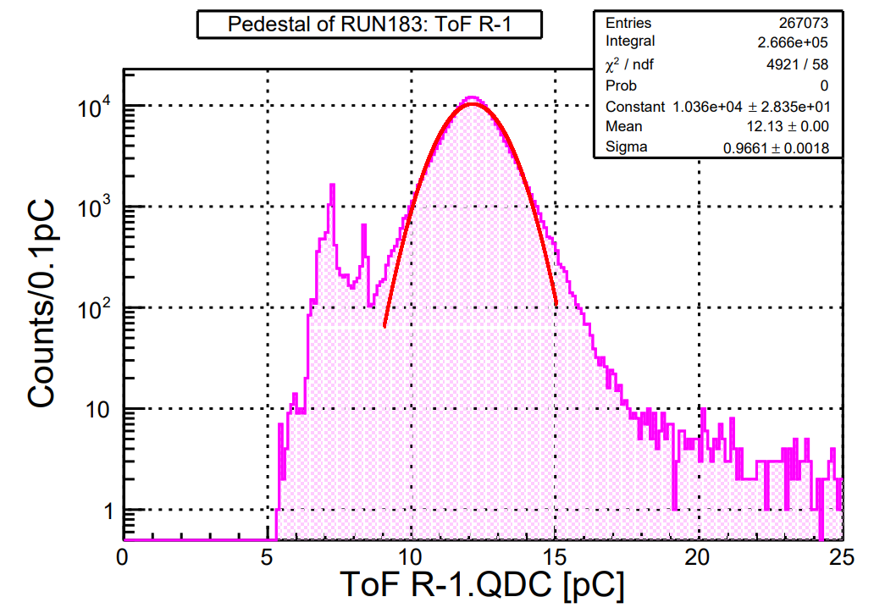
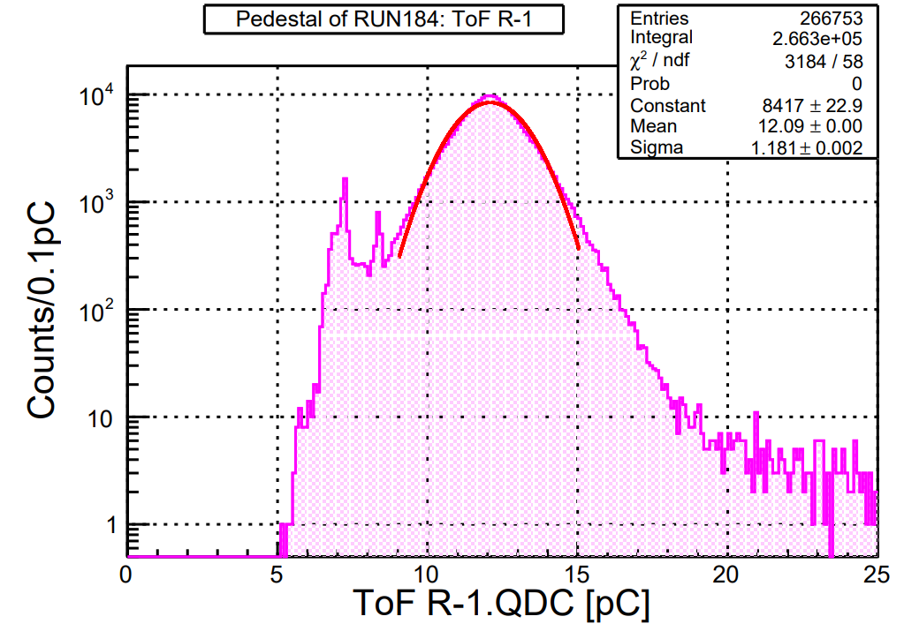
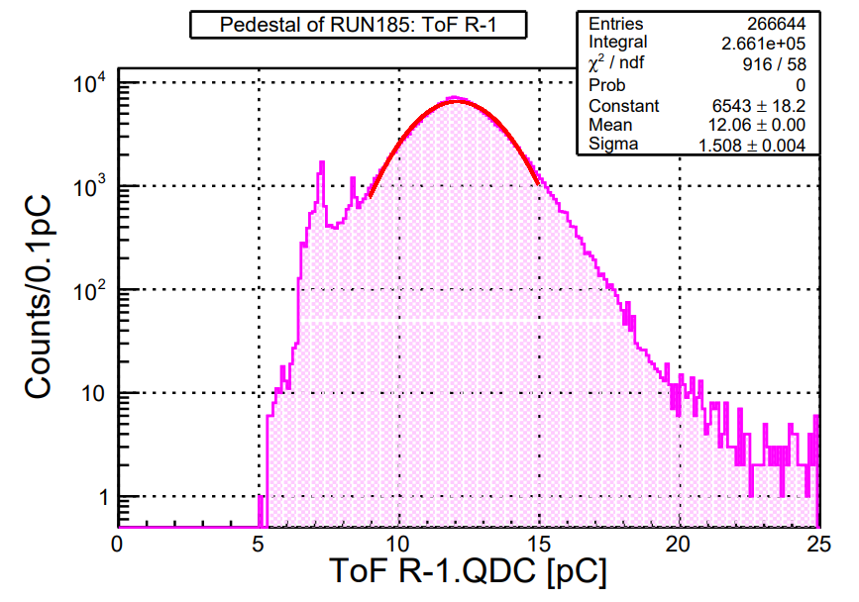
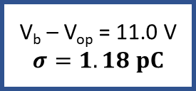
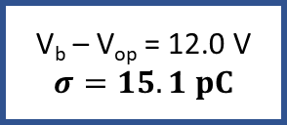
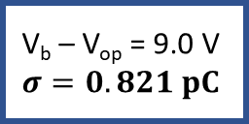
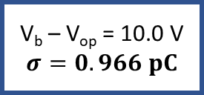
Beam time data analysis
Checked pedestal distribution in high voltage region
V_{b} – V_{op} = 9.0 V
$$σ=0.821 pC$$
V_{b} – V_{op} = 10.0 V
$$σ=0.966 pC$$
V_{b} – V_{op} = 11.0 V
$$σ=1.18 pC$$
V_{b} – V_{op} = 12.0 V
$$σ=15.1 pC$$

Slide 4
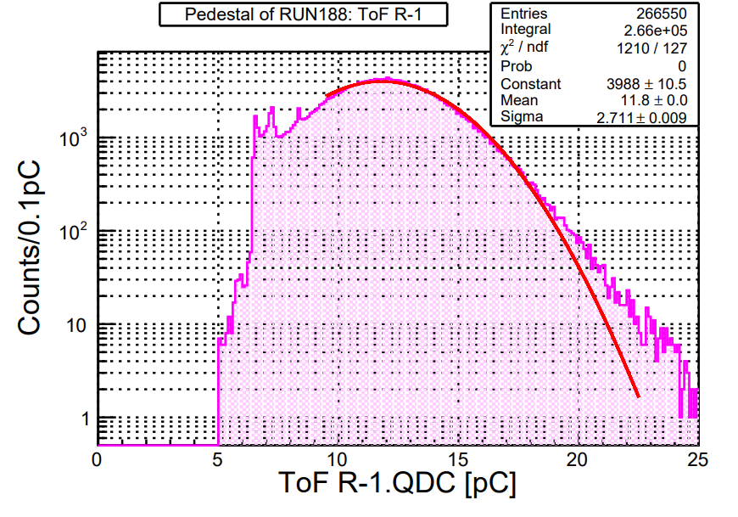
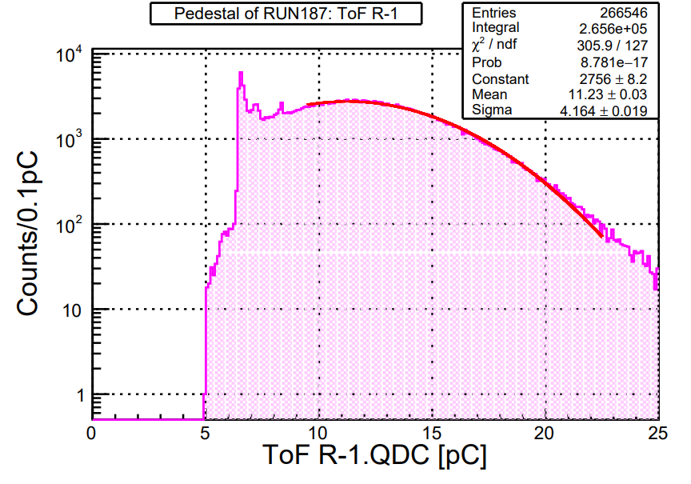


Beam time data analysis
In 53.2V (+13.5V) & 56.7 V (+15.0V)
V_{b} – V_{op} = 13.5 V
$$σ=2.71 pC=27.1 ch$$
V_{b} – V_{op} = 15.0 V
$$σ=4.16 pC=41.6 ch$$

Slide 5
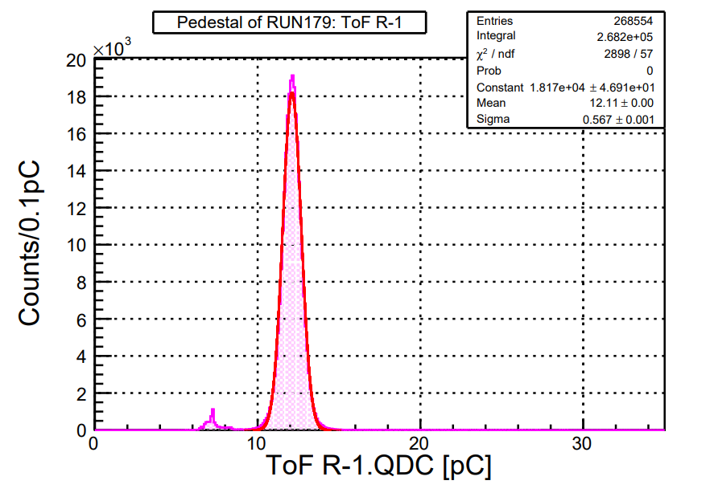
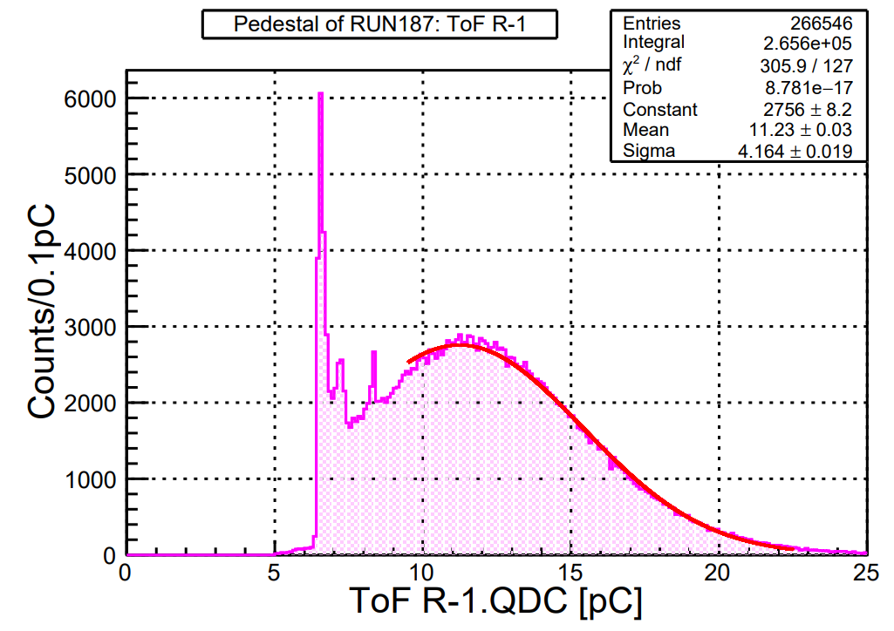
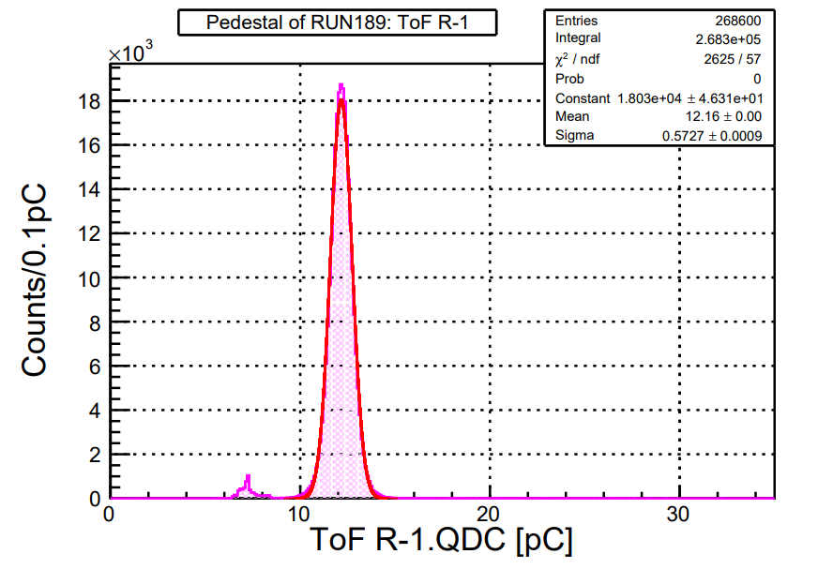
Beam time data analysis
In 56.7V (Linear scale)

Slide 6
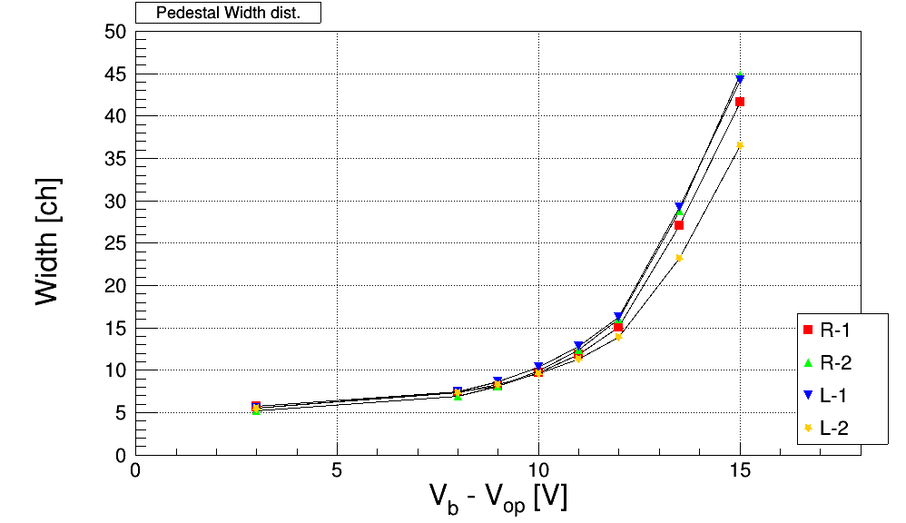
Beam time data analysis: Pedestal

Slide 7
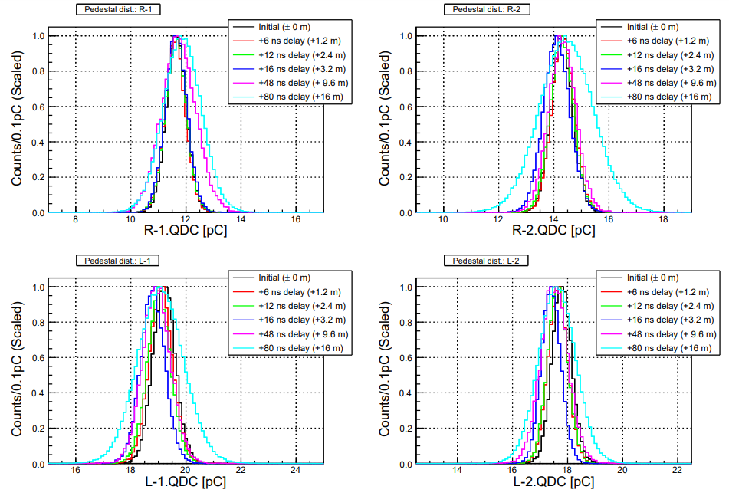
ToF: Cosmic-ray –check cable length dependence-
Pedestal distribution
Scaled peak = 1

Slide 8
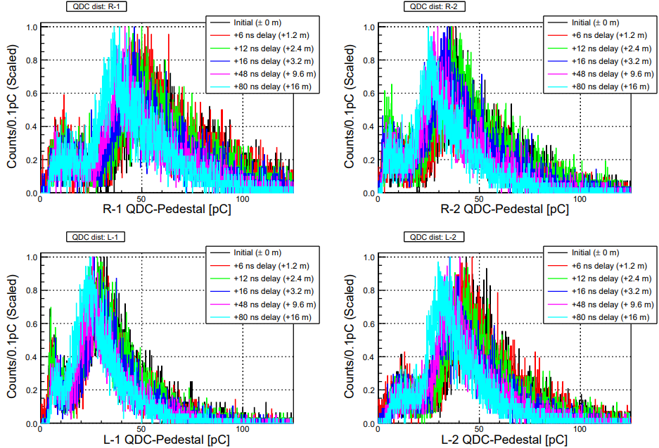
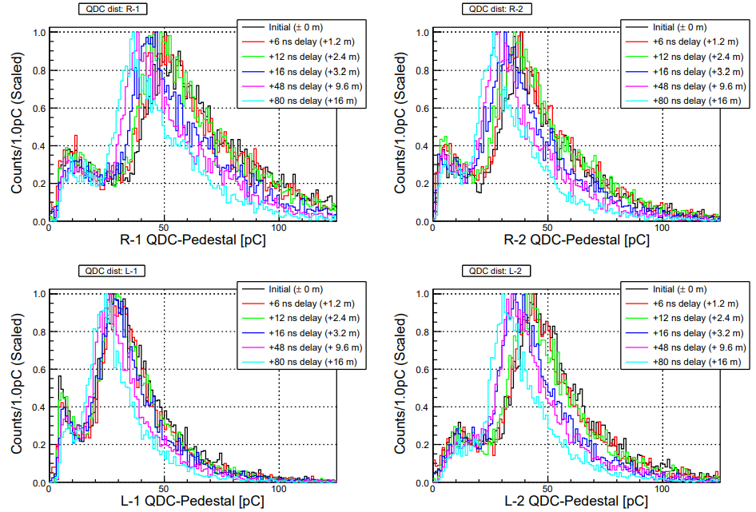
ToF: Cosmic-ray –check cable length dependence-
QDC dist. (Calibrated by pedestal = 0)

Slide 9
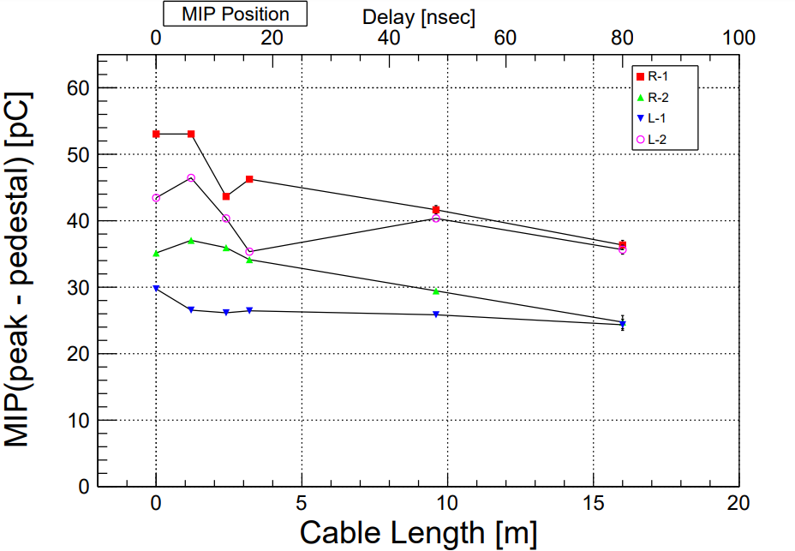
ToF: Cosmic-ray –check cable length dependence-
MIP: Center value with Maximum entry at QDC dist
Slightly decreased MIP value

Slide 10
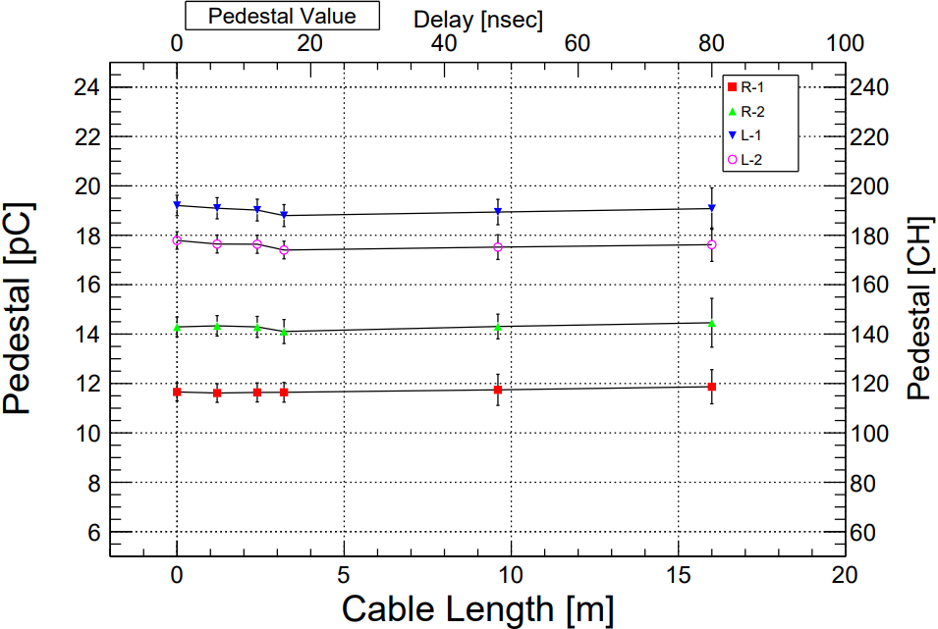
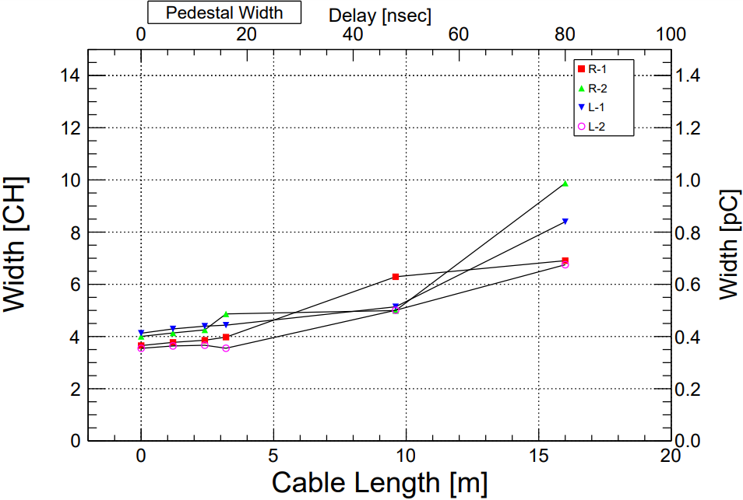
ToF: Cosmic-ray –check cable length dependence-

Slide 11
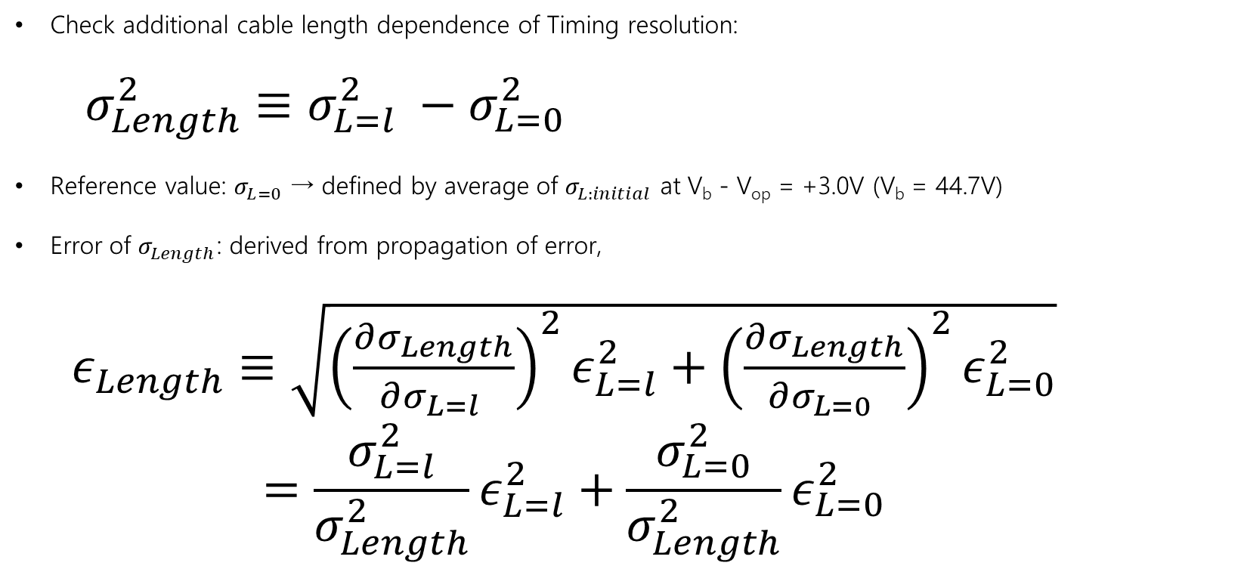
ToF: Cosmic-ray –check cable length dependence-
Check additional cable length dependence of Timing resolution:
$σ_{Length}^{2}≡σ_{L=l}^{2} −σ_{L=0}^{2}$
Reference value: $σ_{L=0}$ → defined by average of $σ_{L:initial}$ at V_{b} - V_{op} = +3.0V (V_{b} = 44.7V)
Error of $σ_{Length}$: derived from propagation of error,
$ε_{Length}≡\sqrt{{\left(\frac{∂σ_{Length}}{∂σ_{L=l} }\right)}^{2}ε_{L=l}^{2}+{\left(\frac{∂σ_{Length}}{∂σ_{L=0} }\right)}^{2}ε_{L=0}^{2}}$
$$=\frac{σ_{L=l}^{2}}{σ_{Length}^{2}}ε_{L=l}^{2}+\frac{σ_{L=0}^{2}}{σ_{Length}^{2}}ε_{L=0}^{2}$$

Slide 12
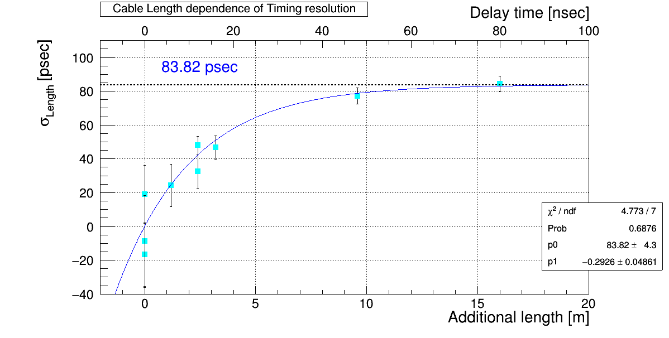
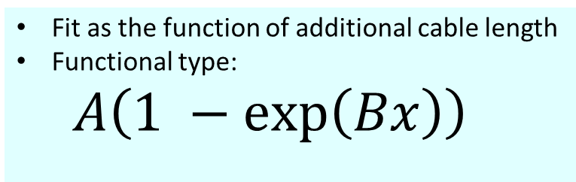
ToF: Cosmic-ray –check cable length dependence-
Fit as the function of additional cable length
Functional type:
$A\left(1 −\exp\left(Bx\right)\right)$

Slide 13
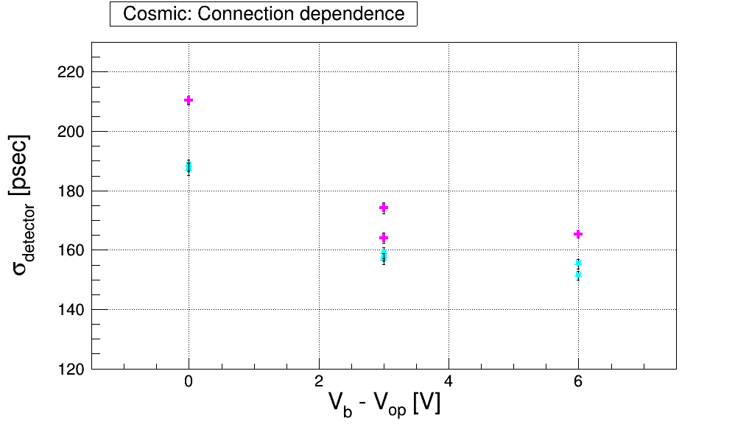
ToF: Cosmic-ray –Connection dependence-
Magenta: scintillator staggered
Cyan: scintillator unstaggered

Slide 14
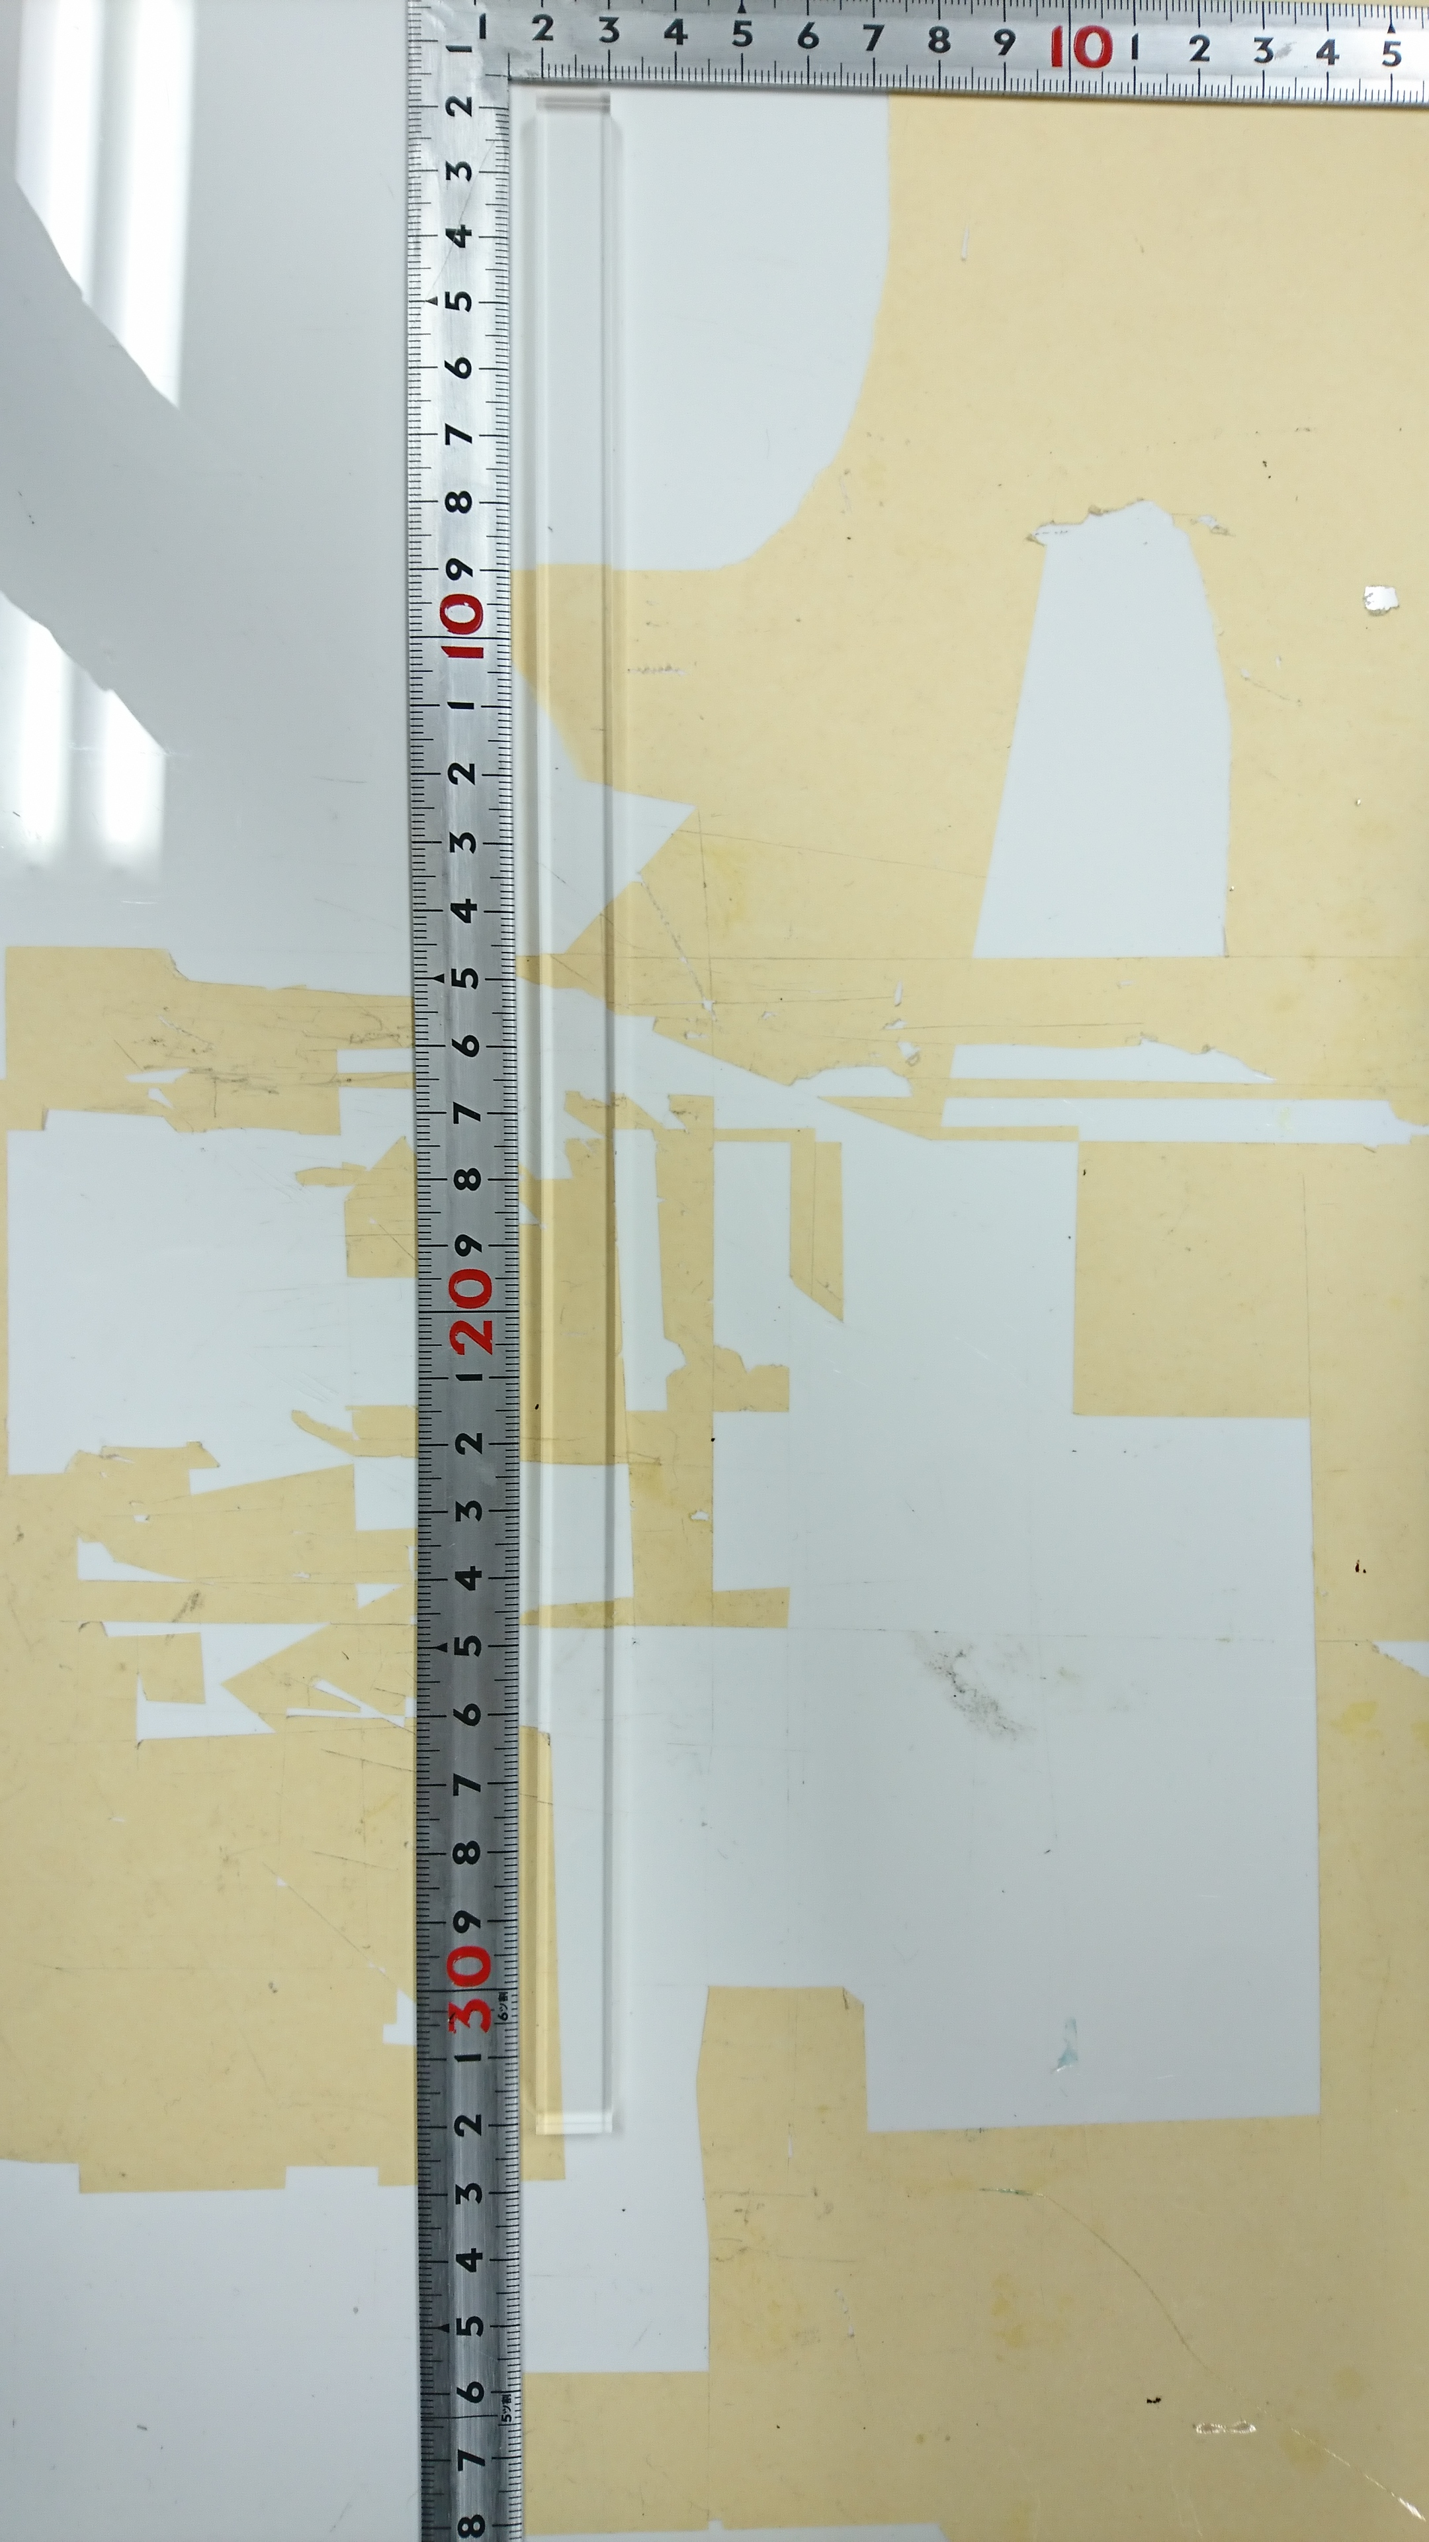
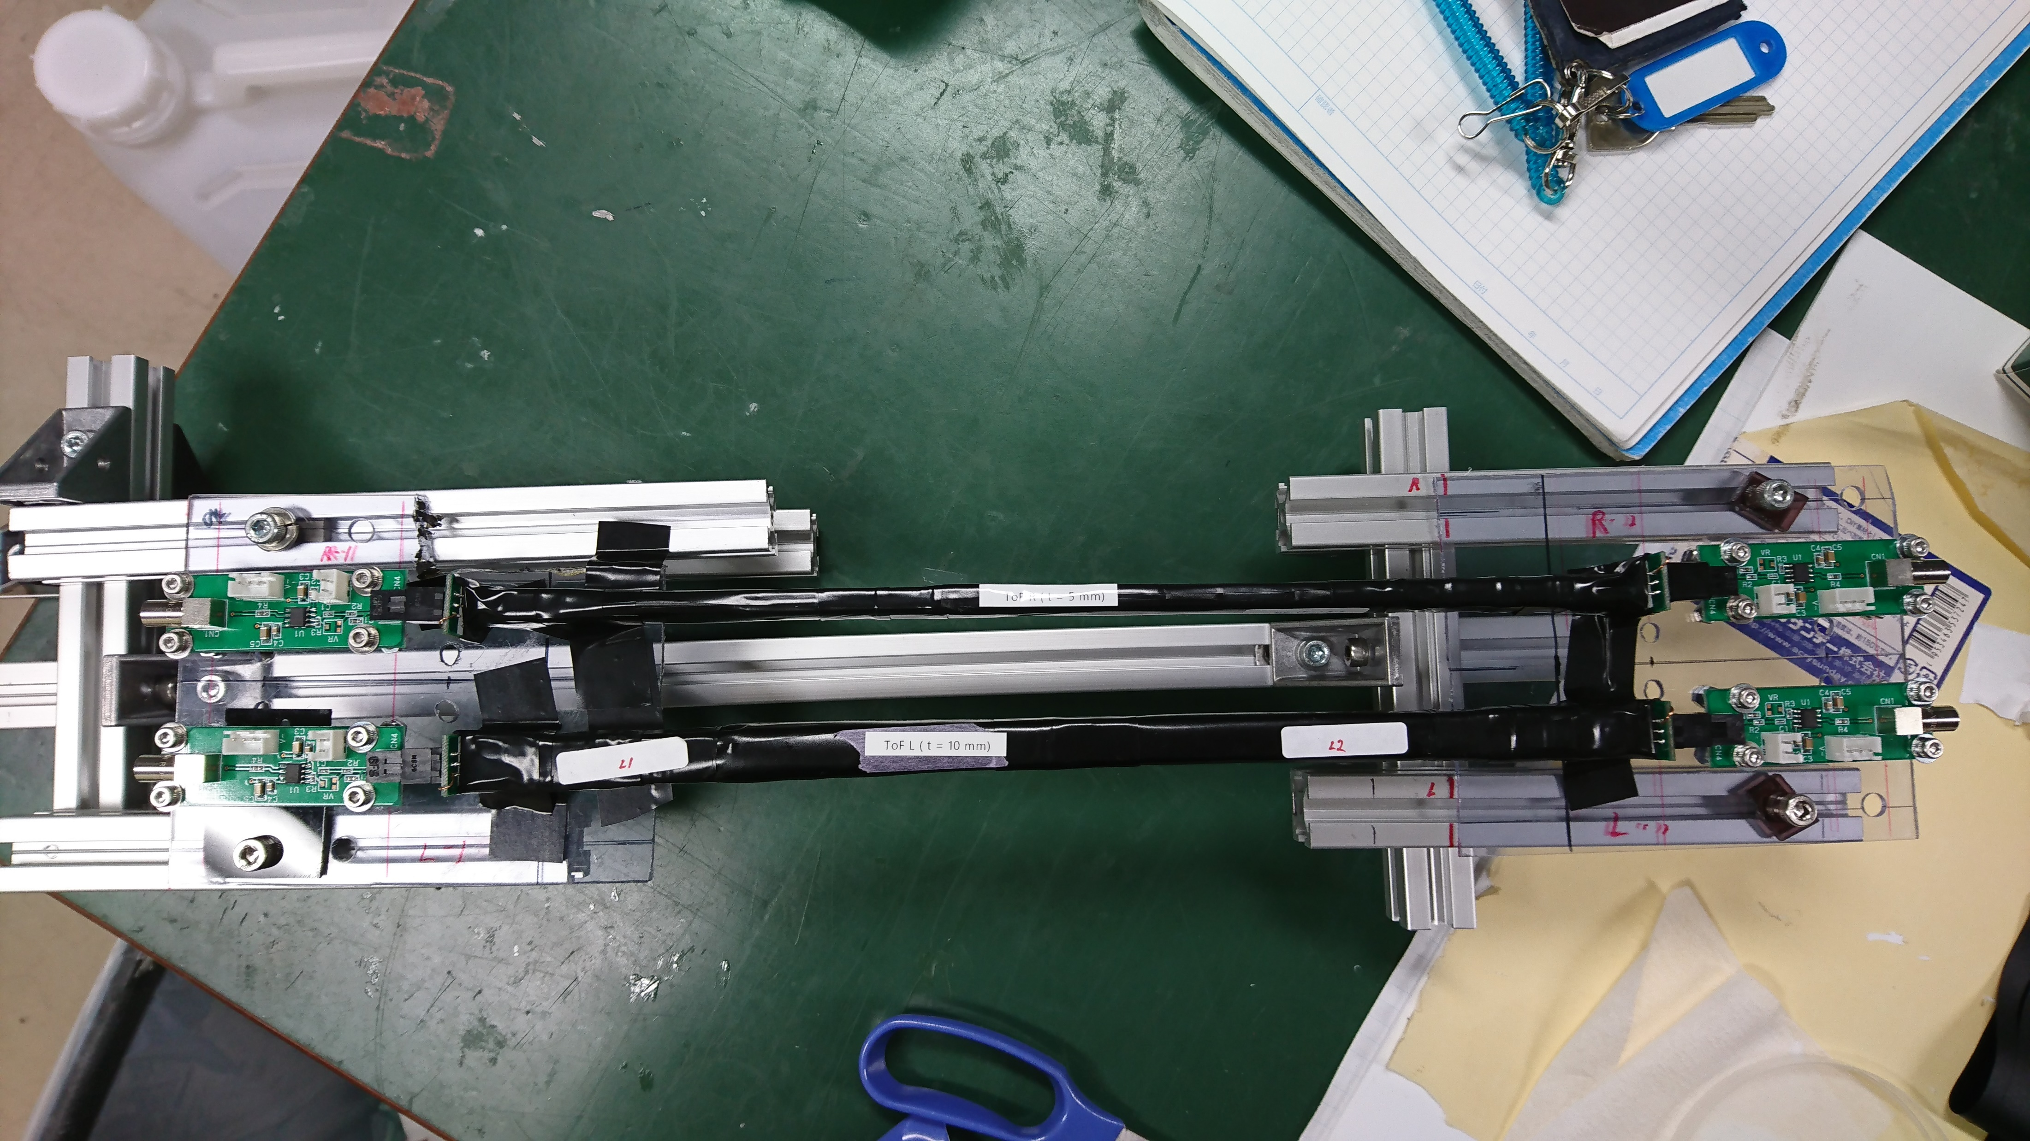
New Scintillator: t = 5mm
Started data taking with different thickness scintillator: 5^{t}×11^{w}×300^{h} mm

Slide 15
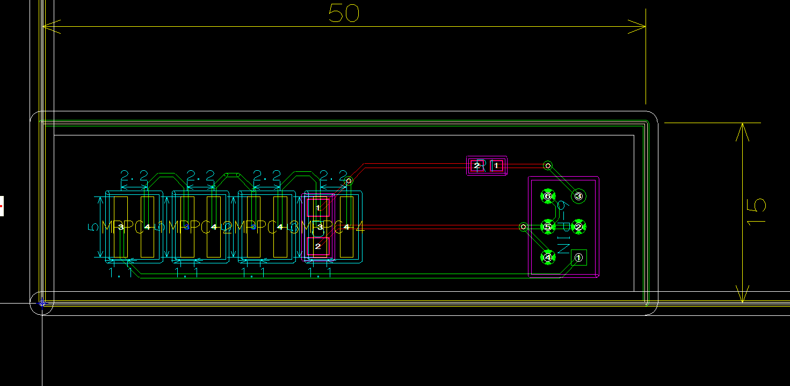
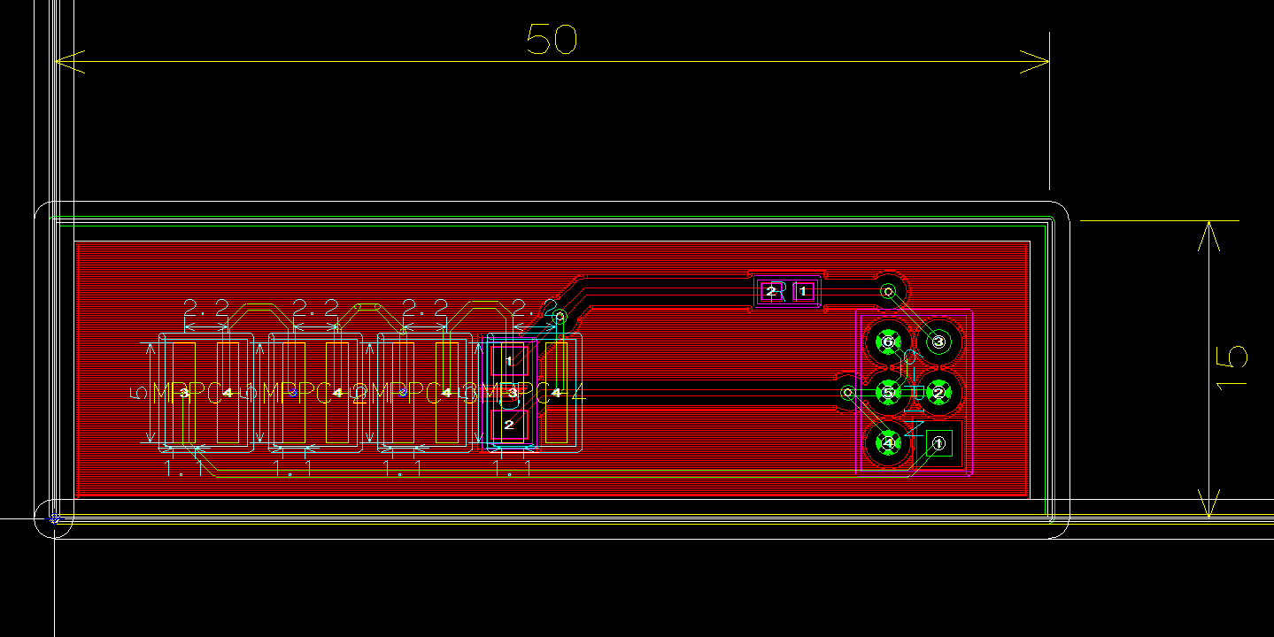
New Circuit design for ToF (MPPC)
Future plan: Study about readout method
Series connection: 直列
Parallel connection: 並列
Task: Design for PCB of each type.
Now: Making Series ver.

Slide 16
To do next
Design new circuit: ~Tomorrow (or next week??)
Scintillator Thickness & width study (Bias & Length) by cosmic-ray
Prepare for second presentation of B4 thesis

Slide 17
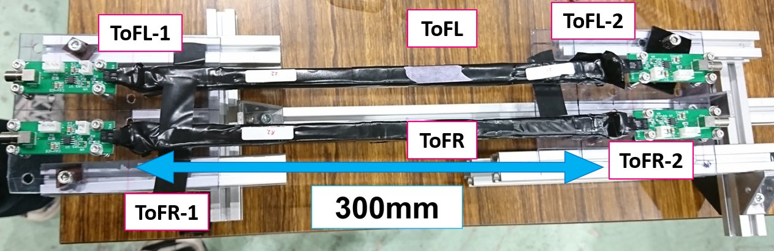

余談
From my presentation of B4 thesis mid-term presentation

Slide 18


余談
似てる(??)
(並べてみたら言うほどでもありませんでした…)

Slide 19
Output form MPPC
Bias supply V_{b}

Slide 26
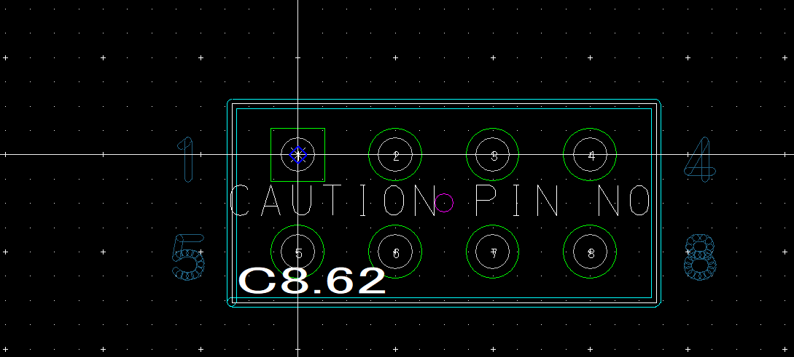
New circuit design using CADLUS X
In CADLUS X, There’s no model of 6-PIN connector (21602X3GSE)
But 4-PIN model (21602X4GSE) exists.
1.27 mm

